Slide 1

AREA COORDINATOR TRAINING

Slide 2
What Are We Going to Cover?
2026 SECC Contact Information
What is the SECC?
How is the SECC Managed?
How Do Employees Participate?
Guidance for Completing Pledge/Gifts
Leadership Givers
Fundraising
What is an Area Coordinator? What are Their Responsibilities?
What is a Unit Coordinator? What are Their Responsibilities?
Summary of Forms
2026 Important Dates
2026 Goals

Slide 3
2026 SECC Contacts
UNITED WAY OF TEXAS
GREG BENNETT
State Campaign Manager
106 E. 6th St Se 900-116
Austin, TX 78701
512-694-2872 | greg.bennett@uwtexas.org
LOCAL EMPLOYEE CAMPAIGN LIAISON
KIM FOX
Manager
Office of Community Engagement
Administration Bldg., Room 318G
1245 TAMU
College Station TX 77843
979.845.8008 | kfox@tamu.edu

Slide 4
2026 SECC Contact Information
SYSTEM CAMPAIGN
Mandy stark
A&M System Campaign Chair
A&M System Offices Staff Council Representative
301 Tarrow Street
College Station, TX 77840
979-458-7120 | mstark@tamus.edu

Slide 5
2026 SECC Contact Information
CAMPUS CAMPAIGN
peter lange monica Martinez
A&M Campus Campaign Chair A&M Campus Campaign Manager
Operations Operations
400 Bizzell, 2302 TAMU 400 Bizzell, 2302 TAMU
College Station, TX 77843 College Station, TX 77843
979-458-0287 | plange@tamu.edu 979-845-4680 | mmartinez@tamu.edu

Slide 6
2026 SECC Websites
STATE OF TEXAS SECC WEBSITE
www.secctexas.org
TAMU & A&M SYSTEM SECC WEBSITE
www.tamus.edu/secc
TAMU & A&M SYSTEM SECC FACEBOOK PAGE
www.facebook.com/TAMUSECC

Slide 7
What is the SECC?
For 30+ years, state, higher education and retired employees have contributed through the SECC to provide support to food banks, homeless or domestic violence shelters, job training programs targeting veterans, and other community programs to help keep Texans healthy, safe, and strong.
Created by Legislation in 1993
First campaign conducted in 1994
Offered Texas state employees greater giving options with hundreds of charitable choices
The only workplace charitable campaign in which state employees can make a voluntary, tax-deductible contribution to charities through payroll deduction, cash, or check
Notes:
Choice!
There are over 400 approved organizations to choose from. You decide which organizations best address your concerns.
Confidence!
All agencies participating in the SECC must meet strict eligibility standards established by state law and are screened by the SECC State Policy Committee. Therefore, you can feel confident your gift is being used efficiently and effectively by your designated charities.
Convenience!
The SECC encourages you to take advantage of the online payroll deduction as a convenient method for giving. – monthly or one-time gift.

Slide 8
How is the SECC Managed?
Governing and Administrative Structure:
State Policy Committee
State Employee Committee
  State Campaign manager
Local Employee Committee
  Local Campaign Manager – United Way of Texas
Charity Review Process:
Charity Application
Administrative Review
Local Employee Committee Review and Approval
Texas A&M University
Texas A&M University Chair
The Texas A&M University System Chair
Texas A&M University
Area Coordinator
A&M System
Area Coordinators
Texas A&M University
Unit Coordinators
A&M System
Unit Coordinators

Slide 9
Campaign Dates
Pledge Period: September 1 – October 31
Reports Due to LCM: November 17
  Have all deposits and reports to GSC Accounting Services by November 12
Payroll Deductions: January 1 – December 31

Slide 10

How Do Employees Participate?
Donation Options
Single Sign-On Workday – Payroll deduction: sso.tamus.edu
  - Monthly payroll deductions (9 or 12 month based on employee status with a $2 per charity, per month minimum).
  - One-time donations to be deducted in January.
Higher-Education Automated Authorization Forms – One-time cash and check gifts only
  - Checks should be made payable to the SECC.
  - https://it-lf-ecmf.tamu.edu/Forms/SECC-HigherEducationAuthorizationForm
Credit Card – One-time gift
  - Donor registers and makes a donation at https://secctexasgiving.org/_brazosvalley/
  - Select appropriate Employer and fill out registration form
  - Activate account per email instructions, select charity and make your donation.
Participation in Fundraisers – numerous options for further support
  - Document donors name on fundraiser participant spreadsheet for donations of $24 or more
Notes:
Employees paid monthly:
Payroll deductions start in December and will be reflected on January paycheck (of the new calendar year).
Employees paid bi-weekly:
Monthly deductions taken from the second paycheck each month, starting in January.
Payroll deductions are made after taxes have been withheld & can be stopped at any time by contacting payroll office.

Slide 11
Guidance for Completing Pledge/Gifts
Donor Designation Options
Employees may select the charities they wish to support from the SECC brochure or the SECC directory (available in hardcopy or on the SECC website).
  https://www.secctexasgiving.org/
Employees may designate to a single charity or up to six different charities from any three charitable groups. The first 2 digits of the 6-digit agency number identify the charitable group.
  Example: 250000 – United Way of the Brazos Valley
  Example: 500000 – Adopt-A-Beach
  Example: 415062 – Mission Road Ministries
HIGHER-EDUCATION AUTOMATED AUTORIZATION FORM -- The employee completes the online form and takes a printout with cash/check to Area or Unit Coordinator.

Slide 12

LEADERSHIP GIVERS
Leadership Givers are donors who donate $1,000 or more.
Leadership Givers are recognized for their gift on the SECCTexas.org website and in the printed directory for the next campaign.
  Donor can opt to not be acknowledged
  Ensure donor’s prefix is listed on form (i.e. Dr., Mr., Mrs., Mr. & Mrs.) if they want it included in their acknowledgment.
Donations from two employees (spouses) can be combined to meet the Leadership Giving required donation of $1,000 or more.
  The Unit Coordinator for each employee needs to email secc@uwbv.org to communicate that the employees wish to be recognized together.

Slide 13

FUNDRAISING
Fundraisers can be a fun way to bring in extra donations.
Check out the Best Practices handout for more great ideas and information.
Invite charity to attend or participate in the event!
An authorization form needs to be completed for each fundraiser and charity(ies) need to be selected for the designation.
Identify donors who contributed over $24 on the fundraising participant spreadsheet.
Notes:
Share Fundraising Best Practices document!

Slide 14
Area Coordinators

Slide 15
Area Coordinator
What is an Area Coordinator?
Manage the campaign activities for divisions of the System and University.
Provide the link between campaign leadership and the Unit Coordinators.
Have Financial Reporting responsibilities.
Administrative Responsibilities:
Work with Administration to set Goal(s) (% or $)
Provides leadership and direction for the campaign in your area.
Appoints unit coordinators to ensure all employees in your area are given the opportunity to participate.
Trains unit coordinators, as necessary.
Serves as a motivator, facilitator, and resource for your unit coordinators.
Delivers weekly deposits on Thursdays

Slide 16
Area Coordinator
Online Contribution REPORTING
Each week, Area Coordinators will receive the following reports on the activity of the campaign. They are welcome to share this information as they see fit.
Please make sure personal information is removed before distributing.
  Weekly Reports:
    SECC Names List By Area
    SECC Summary By Area And Date
    SECC Summary By Area, Type, And Date
    SECC Employee Participation
    SECC Credit Card donation report (from United Way)
    NEW – notification emails of Higher-Education Automated Authorization Form Processing

Slide 17
Area Coordinator Wednesday “To Do” List
Wednesday Mornings:
Complete Higher-Education Automated Authorization form for Area fundraisers
Collect and compile from Unit Coordinators:
  Cash/Check donations, Form 2&4
  Printed Higher-Education Automated Authorizations Forms with cash/check
  Ensure all amounts match and forms are completed correctly
  Fill out the Pledge Report Form envelope, deposit slip and make copies
Check-in with Unit Coordinators to share weekly reports and campaign reminders as well as seeing if they need support on their efforts.
Notes:
The manual has more specific steps for these processing responsibilities.

Slide 18
Area Coordinator Thursday “To Do” List
HAND DELIVER DEPOSIT BAG TO: Financial Management Operations (FMO), 3rd Floor, Ste 3400 BEFORE 3:00 PM
INCLUDE:
Envelope:
  Complete Pledge Report Form on envelope
  Copies of Higher-Education Automated Authorization form from individuals or fundraisers
  Copy of deposit slip
  Form 2 & 4
 Deposit Bag: DO NOT seal the plastic bag!
  Deposit slip
  All cash & checks
  Envelope containing the items above
 Write amount and ‘SECC deposit’ on deposit bag label & on top tab
 Tear off and keep the completed deposit bag tab with your records
NOTE: Cash over $100 should be put in a locked safe until the Thursday deposit or make an early deposit to the GSC cashier by following the normal deposit guidelines. Deliveries over $5,000 should have a security escort.
  KEEP A COPY OF EVERYTHING FOR YOUR RECORDS!
Notes:
Again, this information is in the SECC training manual.

Slide 19
Unit Coordinators

Slide 20
Unit Coordinators
What is a Unit Coordinator?
The front-line members of the SECC team.
Distribute materials to employees, fill out and deliver weekly reports
Answer questions to assist with understanding and participating in the SECC.
Share messages with employees on charities in the SECC.
Administrative Responsibilities:
Be familiar with the payroll donation on SSO, authorization form and credit card processes
Host Fundraisers – document names of fundraiser participants who donate $24 or more.
Deliver forms to the Area Coordinators Wednesday by 9 a.m.
Represent your unit at the training workshop and other meetings as scheduled.

Slide 21
Best Practices
Best Practices for a Successful Campaign
Set a Goal (% and/or $) & post signage around offices
Post on your personal social media
Set a face-to-face meeting with Unit Coordinators
Recruit a Team
Get SECC on staff meeting agenda
Rally the Troops and Make the Ask*
Use the I Gave Button on your email signature and share in your division
Distribute the “We Give” poster to donors to post in their office.
Report, Thank & Inform
*Goal of 100% AWARENESS!
Notes:
Find unique ways to make the “Ask” outside of sending emails which tend to get lost or overlooked.
We will give you a draft post to share on your social media on September 1.
**** Square for fundraisers ****

Slide 22
Summary of Forms

Slide 23


HIGHER-EDUCATION AUTOMATED UTHORIZATION FORMS
Used by:
  Employee: for one-time cash or check gifts only
  Unit Coordinator: document fundraiser
Fundraisers: form must be completed for each fundraiser.
  Coordinator should select charity(ies) to designate funds.
  For “Name” list the unit and title of the fundraiser.
  Identify donors who contributed over $24 on the attached fundraiser participant spreadsheet.
The link to this form is available on the SECC website tamus.edu/secc.

Slide 24
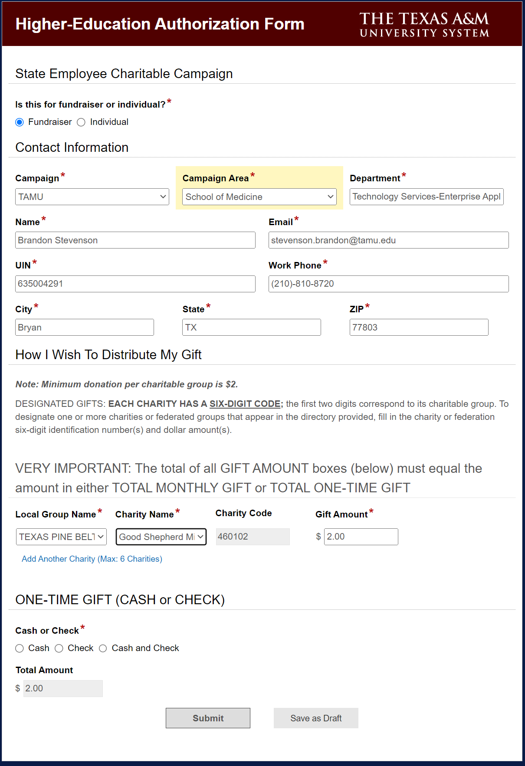
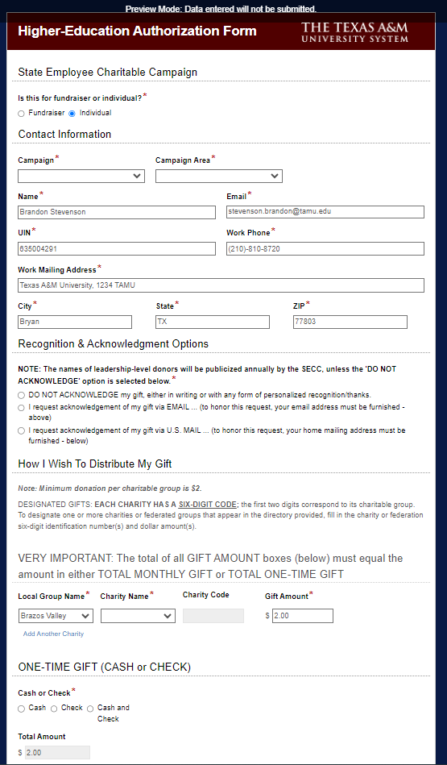
AUTHORIZATION FORMS

Slide 25
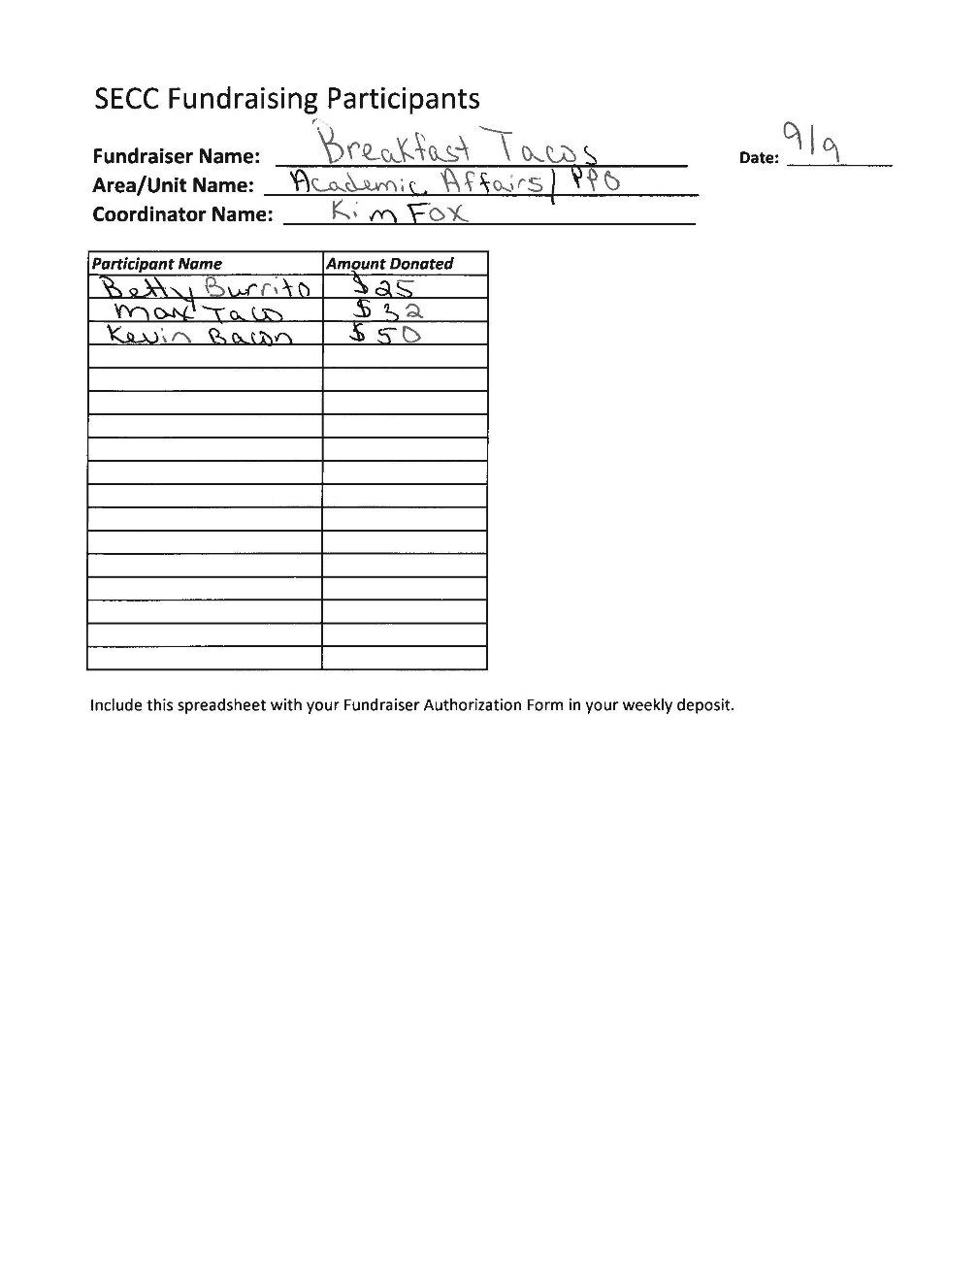
FUNDRAISER PARTICIPANTS
Used by:
  Unit Coordinator: document fundraiser participants of $24 or more
Attachment with the Higher-Education Automated Authorization Form processing
Available on the website at tamus.edu/secc

Slide 26
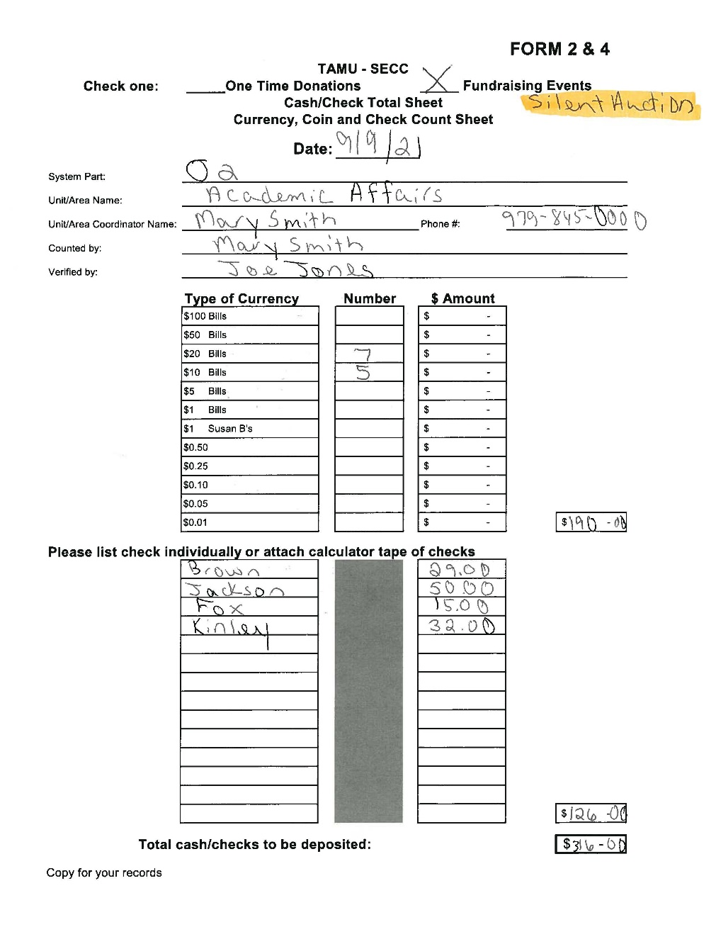
FORM 2&4
Completed by Unit Coordinators; reviewed by Area Coordinators
For all cash and check donations, whether one-time or fundraiser
Retain a copy for your records
Available for download on the SECC website tamus.edu/secc

Slide 27
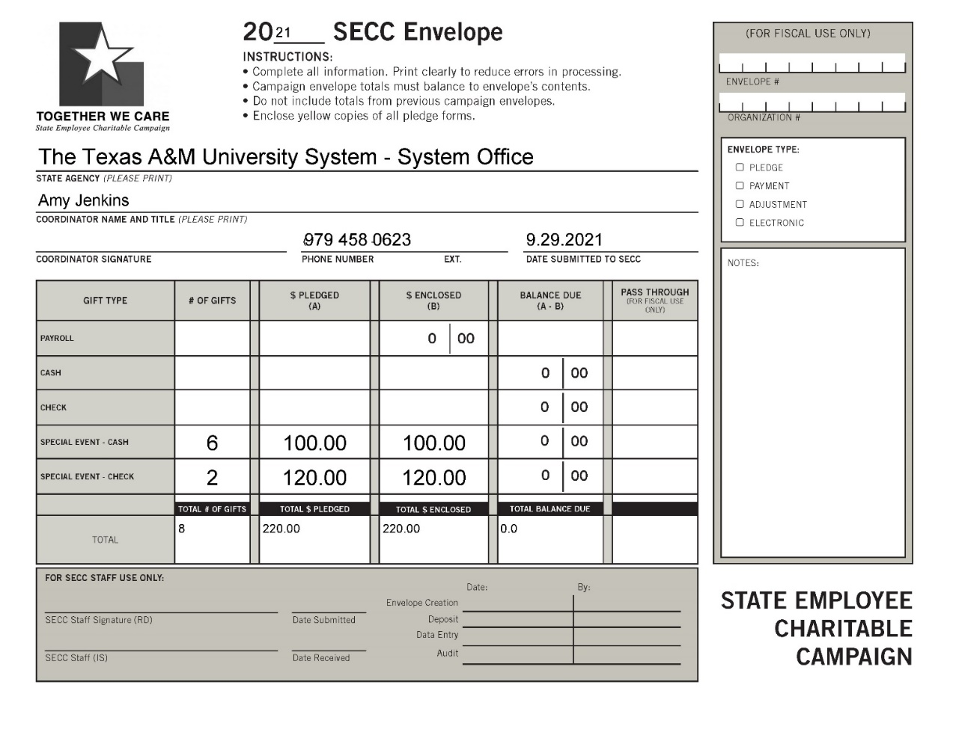

PLEDGE REPORT FORM ENVELOPE
Used by the Area Coordinator only
Complete anytime you are depositing funds / paper forms.
Instead of mailing/dropping off at United Way, drop off in the GSC Financial Management Services with deposit batch.

Slide 28
DEPOSIT SLIPS
Used by the Area Coordinators only
Bank: WELLS FARGO
Complete for United Way of Texas cash and check deposits.
Place in plastic deposit bag with cash and check payments.

Slide 29
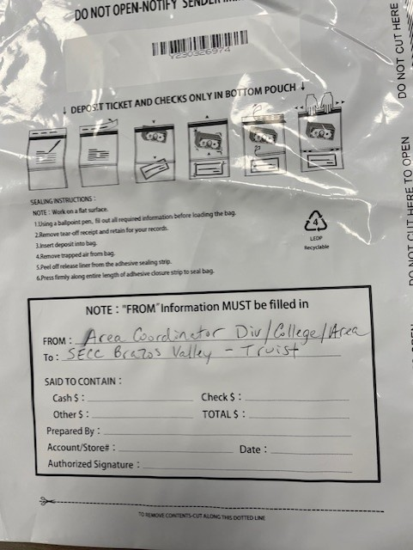
DEPOSIT BAG
Used by the Area Coordinators only.
Plastic envelopes used to place cash, checks and deposit slips in for weekly deposit delivery.
Complete information on the front of the bag along with the top tab noting “SECC deposit” on label and tab top. Tear off top tab and keep with your records.
DO NOT seal the deposit bag. Secure closed with a clip. FMO will verify deposit amount.
Notes:
NOT TRUIST ANYMORE!!
Wells Fargo

Slide 30

2026 Goals
Campaign Goal:
University- $300,000
A&M System - $250,000
TOTAL - $550,000
Participation Goal:
University - 8%
A&M System – 8%
Notes:
2025 Results –
System – $208,003.87 4.9%
University – $286,515.29 6.1%
TOTAL – $494,519.16 5.6%

Slide 31
SECC 2026 Important Dates
August 24-28 – Distribute Materials
August 31 – Campus email from the President
September 1 – Campaign kicks off; SSO and credit card giving sites LIVE;
  Early Bird Incentive BEGINS on Campus
September 2 – Campus email from the Campaign Chair
Wednesdays – Unit Coordinators deliver Forms, Cash and Pledges to Area Coordinators
Thursday – Area Coordinators prepare and deliver deposits to DAS
September 10 – Volunteer Opportunities Fair for ALL employees
September 15 – Early Bird DEADLINES
October 1 – Better Late Than Never BEGINS on Campus
October 15 – Better Late Than Never DEADLINE
October 31 – Campaign ends
November 12 – Final Processing Deadline!

Slide 32
THANK YOU!
For your efforts in making the 2026
State Employee Charitable Campaign a success!

Slide 33
QUESTIONS??

Slide 34

FOR MORE INFORMATION, PLEASE VISIT
TAMUS.EDU/SECC
Notes:
TURN IT BACK OVER TO CHAIRS FOR FINAL COMMENTS

